Slide 1
Circularity
@ CWS Workwear
This is how sustainable we are!

Slide 2




We put a premium on circular economy
Repair | Reuse | Recycle
Sustainable
business model
Use of sustainable materials
Recycling & eco-design
thanks to our circular economy
Keep long-life products in the circular flow

Slide 3
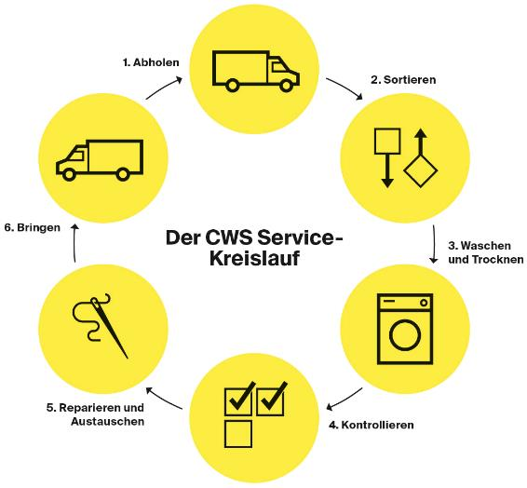
Leaders in sustainability
Circular economy is the fundamental principle behind our business model. The CWS service model is geared to cutting environmental impacts and slowing down the materials cycle. “Use” and “reuse” instead of buy and replace.
But we do a whole lot more!
1
Sustainable materials
Durability
Initiatives for sustainable design
2
Responsible supply chain
Total transparency in our in-house production
Active social audits (BSCI)
3
Resource-saving care of workwear
Reuse of water and energy
Repair & reuse of workwear
4
Textile management for long service life and reuse
Downcycling, recycling and upcycling

Slide 4
Circular advantage
Service model vs purchasing
Textile services cut the environmental impacts of workwear by more than 70% on average – considering the repair and reuse cycles.
This equates to average savings on CO₂e of 550,000 kg per year and 10,000 employees.*
550,000 kg CO₂e equate to driving a distance of 3.5 million km with a mid-range car.
72 kg Co₂
Purchase
-76%
17 kg Co₂
Service model
36 kg Co₂
-50%
Service model including transport
* Repair and reuse of textiles reduce the amount of new textiles that would otherwise be needed. We compared the environmental footprint involved in purchasing and that of the service model for four main collections with an annual throughput of 500,000 items. The climate impact calculations are based on N.M. van der Velden et al. 2013: LCA benchmarking study on textiles made of cotton, polyester, nylon acryl, or elastane. In Int J Life Cycle Impact

Slide 5

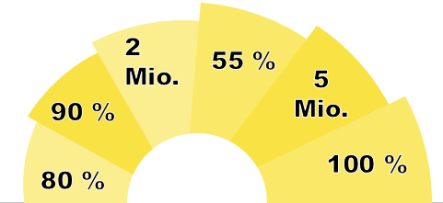


Sustainability expressed in figures
55% of our workwear is recycled or reused when its service life is over.
We have over 2m items of sustainable workwear in service.
By 2024: Proportion of sustainable materials in workwear to be raised to 90%.
CWS repairs approx. 5m items of workwear per year.
Water recycling rate in our laundries stands at 80%. Washing water is reused for mats, for example.
Green electricity in use at all plants/facilities.

Slide 6

Durability counts
Quality control and optimisation: In the CWS Test Centre
CWS has been operating its own quality assurance test centre for 35 years.
Tracking of each collection’s wear rate
Determination of washing processes per item
Tracking of product-related complaints
Quality and washing test before product roll-out
Continuous product optimisation
Melanie Deppe
Head of Quality at CWS Workwear
Testing for durability, colour fastness, shape retention
Objective: Long workwear service life

Slide 7



Responsibility in the supply chain
Transparent & controlled
Own design team in Germany and in-house production in Europe.
Control of our supply chain.
Suppliers are obligated to acknowledge and sign our CWS Code of Conduct.
Regular independent BSCI-conform audits of production sites.
90% of our suppliers are from Europe.
CWS has applied the strict BSCI Code of Conduct in its supply chain since 2013. All relevant suppliers are audited for and in compliance with this at least every 2 years.
CWS signed up to the UN Global Compact in 2013 –the biggest and most important initiative worldwide for sustainable and responsible corporate governance.
Platinum Award. Sustainability audit covering environment, labour and human rights, ethics and supply chains. CWS figures among the top 1% of the audited companies.
Already over 50% of purchased textiles certified to Oeko-Tex STeP for environmentally friendly and socially responsible textile production.

Slide 8
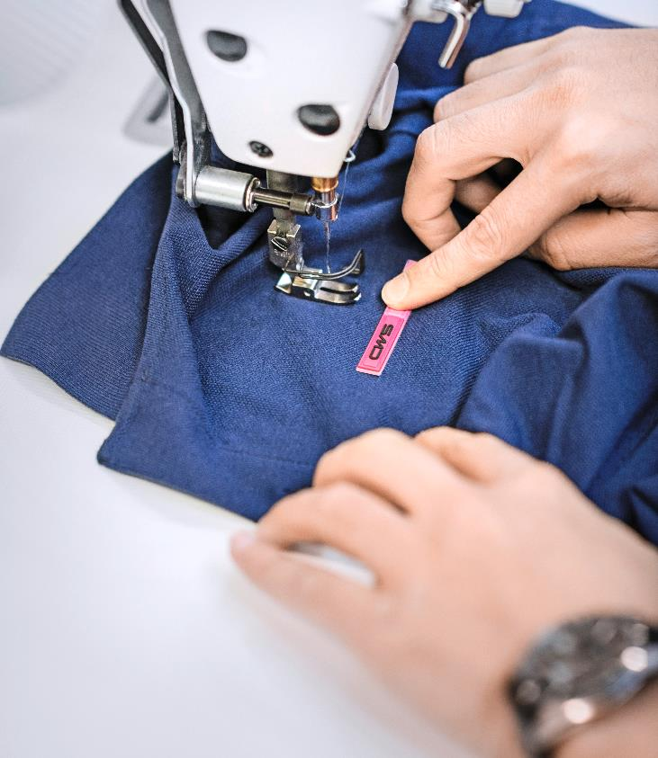
Repair and reuse of sustainable materials

Slide 9
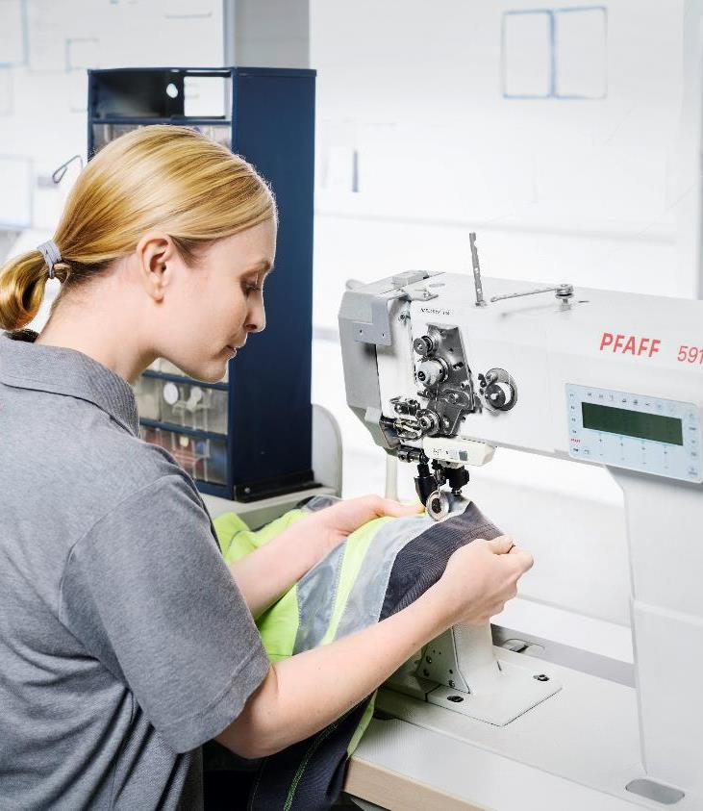

Repairing
pays off!
We put a premium on long service life for our workwear.
Which is why we use high-quality, durable garments and repair them expertly.
By doing so, we prevent textile waste and at the same time cut CO₂ emissions considerably.
CWS repairs around 5 million items of workwear per year.

Slide 10
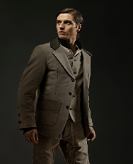
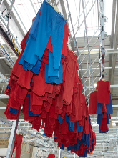
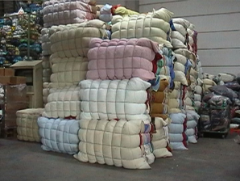

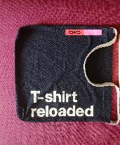

Reuse
CWS has delivered around 1 tonne of used workwear every year since 2005 to the Berlin-based fashion designer Daniel Kroh who creates his menswear from CWS workwear.
The lion’s share of the workwear goes to resellers. Workwear is made fit for use again and sold.
1.8 tonnes of clothing donated monthly to the Caritas welfare association, trainees in need, senior citizens and children‘s homes, prison workshops, hostels for the homeless.
CWS is main partner in the wear2wearTM industrial partnership. Objective: to close the textile cycle for the future by using recyclable materials.
55%
reuse & recycling
of CWS workwear –
and the trend is upwards.
Recycling of our workwear into bags as promotional gifts for customers and trade fair visitors.

Slide 11
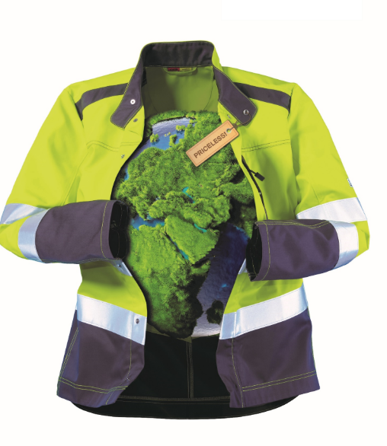



Sustainable materials
Overview
Our objective:
“By 2024 we aim to
ensure that 90% of the products we use in new business are sustainable”
CWS already has 2 million items of sustainable workwear in circulation:
Workwear with Fairtrade cotton, recycled polyester, sustainable viscose (e.g. Tencel), organic cotton.

Slide 12
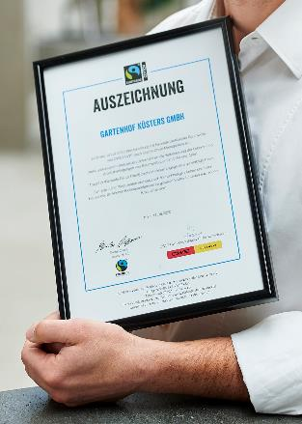
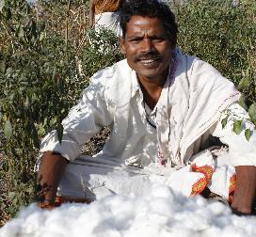
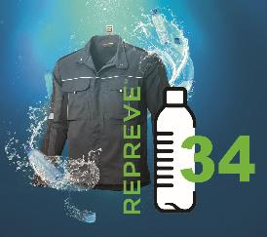


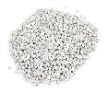
Sustainable materials
Production
Guaranteed minimum price for Fairtrade farmers and sustainable cotton production.
+
Bonus for farmers for participation in collaborative projects
No exploitative child labour, no forced labour
No hazardous chemicals or genetically engineered seeds
Water-saving cultivation
Over 1 m items with Fairtrade cotton in circulation since 2016. We are pioneers.
Our recycled polyester consists of
  PET bottles
  Industrial waste plastics
Fairtrade award for CWS customers with Fairtrade workwear
More than 207 tonnes of recycled polyester processed in 2020.

Slide 13
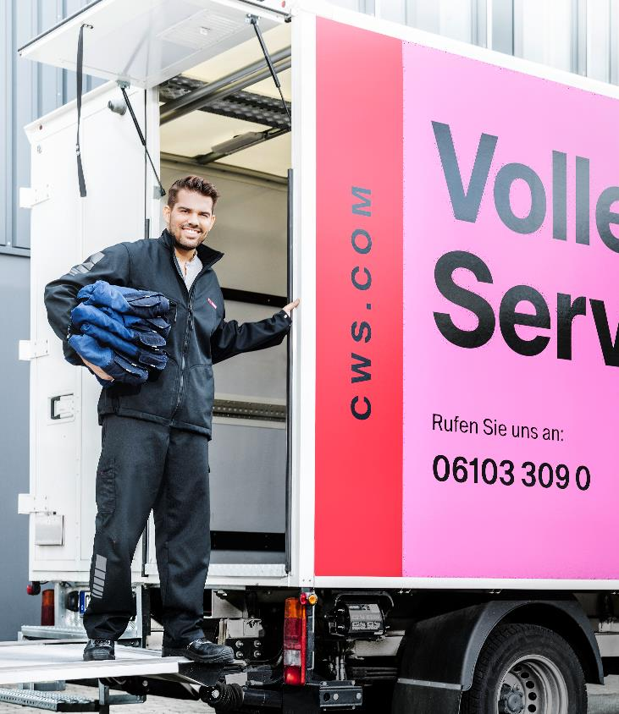
Laundries
& logistics

Slide 14
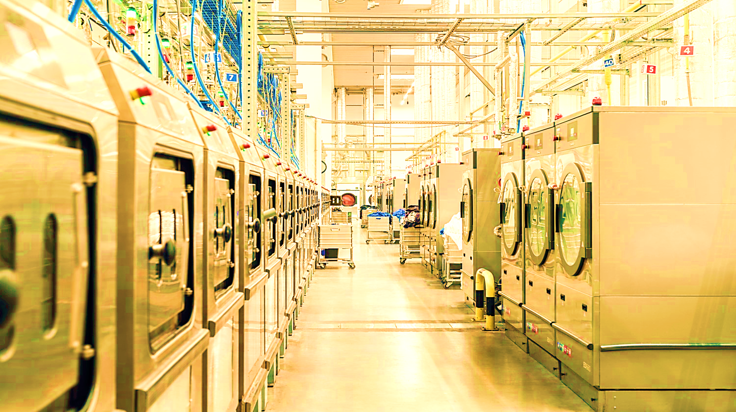
“Over the past 20 years we have optimised our CO₂ efficiency by 60%”*
* CO₂ per laundered kg. Comparison of data from the LCA study conducted by the Eco Institute for the ETSA association with current CWS data

Slide 15



Optimisations in the laundries
Modern technologies
Reuse and recycling of water
Low-temperature washing processes
Automated and optimised dosing of detergents, water and temperature, geared to the nature of the workwear and degree of soiling.
Heat exchangers
Green electricity at all plants & facilities.
We recycle up to 80% of the water we use.
After the washing process, washing water is pressed out of the washed clothing. Dirty laundry, e.g. mats, can then be soaked in this expressed water. This saves energy, since the water is still warm and requires no heating.
In a number of laundries we use low-temperature washing processes (reduction by 30 degrees) that provide the same hygiene standards as the other procedures.

Slide 16
Certified laundry processes
CWS laundry versus home laundering
Hygienic and harmlessness
Hygiene & harmlessness
CWS workwear is ecologically harmless, certified to OEKO-TEX® STANDARD 100
Washing processes certified to:
Quality management to DIN EN ISO 9001
RABC hygiene management to DIN 1406
Environmental management to DIN EN ISO 14001
Washing using detergents free of harmful ingredients
and aromatic substances.
Professional CWS rinsing processes with fresh water
leave far less detergent residues behind than is the case
with home laundering.
Household detergents frequently contain environmentally harmful aromatic substances.
In most cases no separation of private and clothing and workwear: hygiene risk.
Efficiency
Efficiency
Ideal combination of temperature | detergent | time for hygienic washing.
Water is filtered and treated so that soiling such as oils or fats are not drained into the wastewater.
Optimal capacity utilisation of the washing machines makes for efficient energy consumption.
No expert knowledge on dosing of detergents and heat
Only standard washing programmes and settings are possible
Dirt residues are drained into the wastewater
Optimal capacity utilisation of the washing machine not guaranteed.

Slide 17

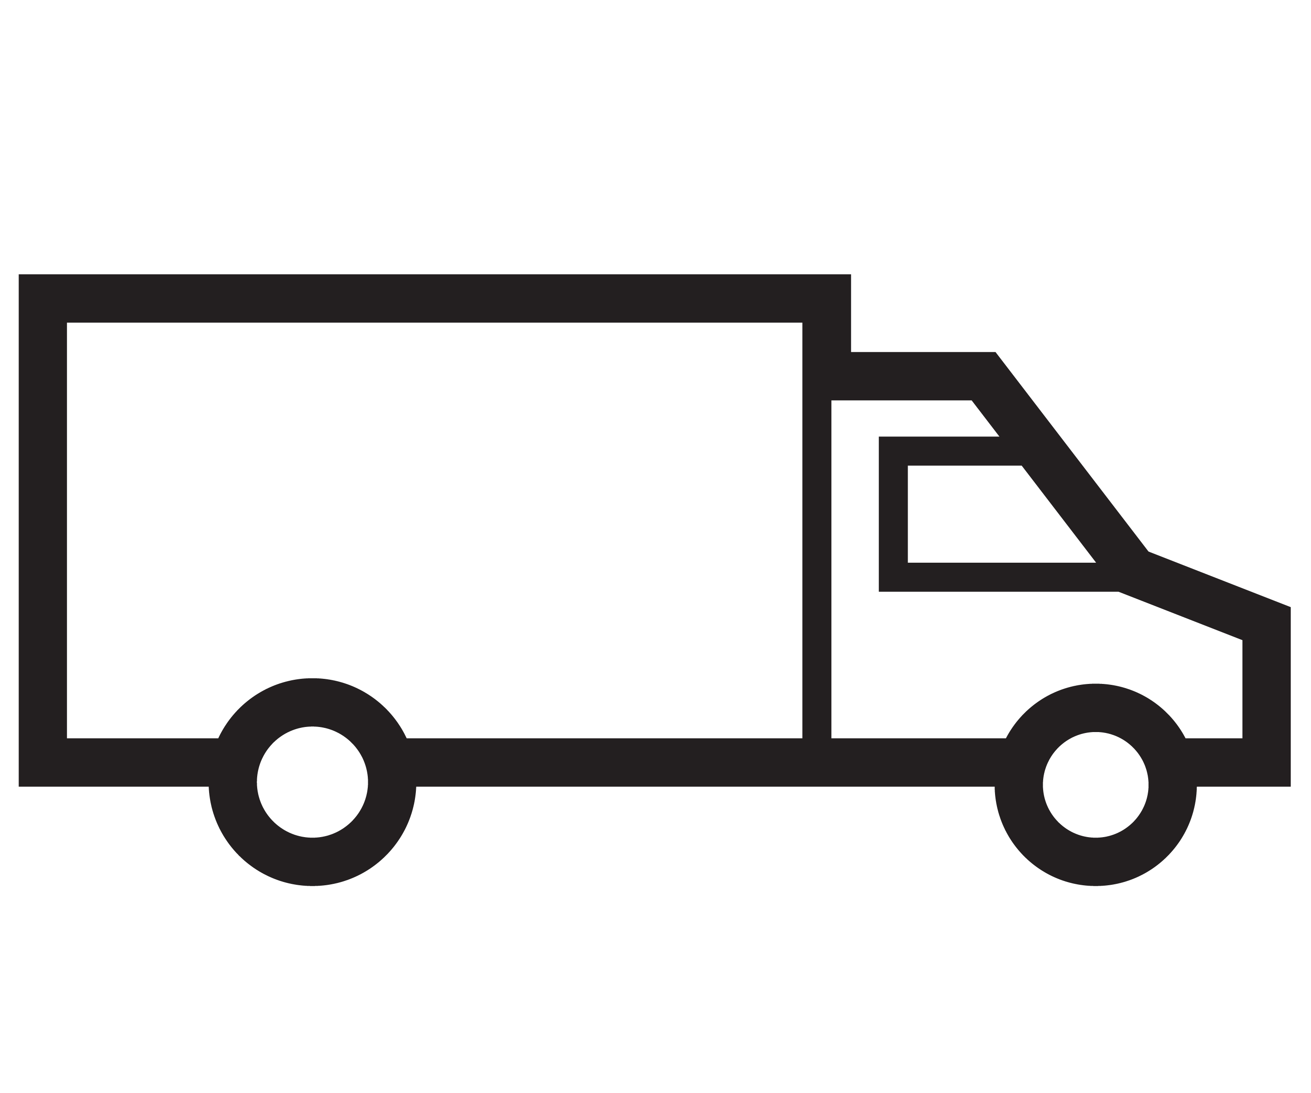
Optimisations in logistics
Alternative fuels & technologies
Route optimisation – Second Level (service logistics)
Route optimisation –
First Level (logistics)
Modern service fleet with EURO 6 & 5.
Tests with e-mobility in service logistics.
Use of natural gas (CNG) in logistics.
To reduce greenhouse gas emissions, CWS is optimising the routes by identifying the shortest possible distances for them.
Optimal loading. The more that can transported by service vehicle, the better the CO₂-efficiency (CO₂e per km und kg).
We shall be splitting up Workwear and Hygiene logistics in the future to ensure better utilisation of logistics capacities.
Optimisation of logistics routes in transport from warehouses and depots.
Identification of the shortest route.
Optimum loading of trucks. The more we transport, the better the CO₂ efficiency (CO₂e per km and kg).

Slide 18
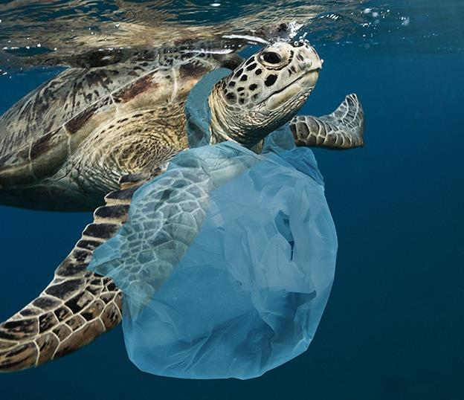
We’ve declared war on plastic waste!
We are reducing the individual packaging of items when delivering workwear since it is not hygienically essential.
Considerable savings on packaging material
that customers would otherwise have to
dispose of.
By 2021: Deliveries made with textile bags to all customers in Germany.
Over 400 million tonnes of plastic are produced every year worldwide – and that equates to more than 50 kg per person. Each and every reduction counts!

Slide 19




Objectives for 2025
We have ambitious goals on our agenda!
50% of management positions to be occupied by women. CWS is signatory to Germany’s Charter of Diversity.
Occupational accident rate* of 0%.
100% of colleagues for whom compliance is a relevant requirement will have completed corres-ponding training courses.
Climate strategy for continuous reduction of our carbon footprint.
* Number of reported accidents x 200,000 / Number of hours effectively worked

Slide 20

Sustainable structures at CWS

Slide 21
CWS sustainability structure
Vision
For a healthier and safer future!
  Our understanding of sustainability is based on the circular economy. We develop sustainable and circular solutions for the workwear, hygiene and fire safety markets to address the global challenges of resource scarcity and climate change. We aim to become the most sustainable company in our industry and work actively with our employees, customers and shareholders to that end.
Priorities
Sustainable products
Responsibility along the supply chain
Decarbonisation
Closing of resource cycles
Best-in-class workplace
Materials & service life
Social & ecological
responsibility
Logistics &
laundry
Upcycling & recycling,
waste
Health & safety,
diversity
Basis
Strategy& review
We make sustainability an integral element of our corporate strategy and business decisions.
Partnerships
By way of cooperative projects and partnerships we are creating an ecosystem for the sustainability transformation.
Report
Creation of transparency about sustainability effects and performance as well as communication of progress made.
Culture & training
Sustainability as integral element of our corporate culture.

Slide 22
Sustainability governance
Support from the very top: Sustainability is fostered from and by the top management level at CWS and lies within the CEO’s sphere of responsibility. The highest CWS decision-making body has a representative with responsibility for the topic of sustainability who regularly discusses the sustainability strategy with the other members. She is supported by a team of sustainability managers with various focal areas.
Sustainability strategy and implementation: The sustainability goals are managed on an equal footing with and alongside our market and financial objectives. The sustainability goals form part of the formal strategy implementation processes. Sustainability goals are fostered and supported by all sections of the company's top-level management.
Sustainability projects and measures: Projects that play a role in achieving the sustainability strategy's objectives are implemented with interdisciplinary teams. As regards the topic of more sustainable products, the sustainability team therefore works closely with Purchasing and Product Management.

Slide 23





Our foundation
Core Behaviours
  Think “Customer first”
  Empower others
We make it easy to do business with. Our customer is the centre of everything we do.
We engage our employees through open feedback, collaboration, transparency and teamwork.
  Improve every Day
Take Ownership
  Compete for Success
We challenge the status quo and quickly embrace change. We keep it simple and impactful.
We are accountable for our targets and always deliver on our commitments.
We are determined to win with a clear drive to reach our goals. We have the courage to make difficult decisions.

